Slide 1


Kivy Basics
Label, Button, Image, Window

Slide 2
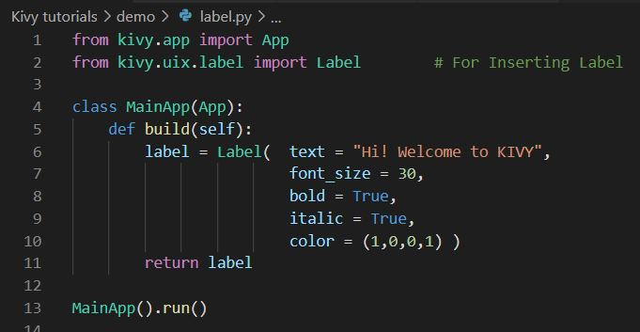
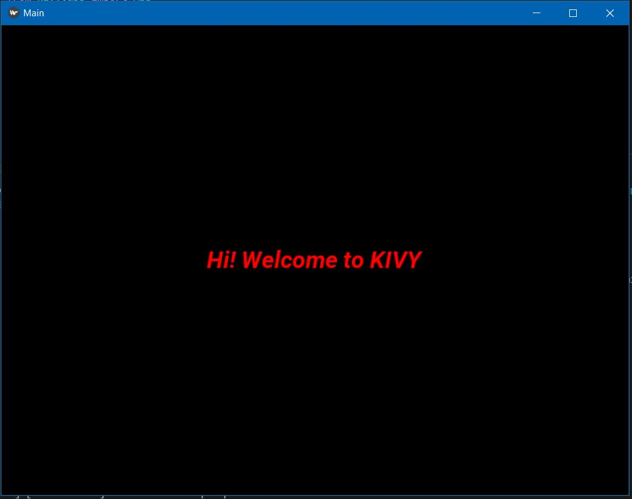
Label
Import kivy app --> from kivy.app import App
Import Label --> from kivy.uix.label import Label
Line no : 4 <Class MainApp(App)> --> Main is the app name

Slide 3
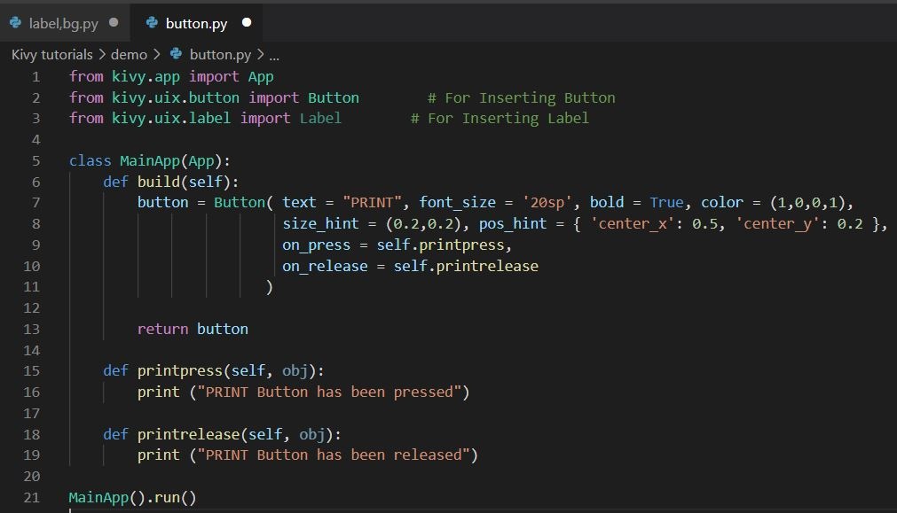
Button
size_hint
size of a button
while changing app size, size_hint helps to changing button size automatically
Import kivy app --> from kivy.app import App
Import Button --> from kivy.uix.button import button
pos_hint
position of a button
while changing app size, pos_hint helps to changing button position automatically
on_press
While pressing/clicking a button, then goes to the function <fn must be inside the class>
on_release -- After pressed/clicked a button, then goes to the function

Slide 4
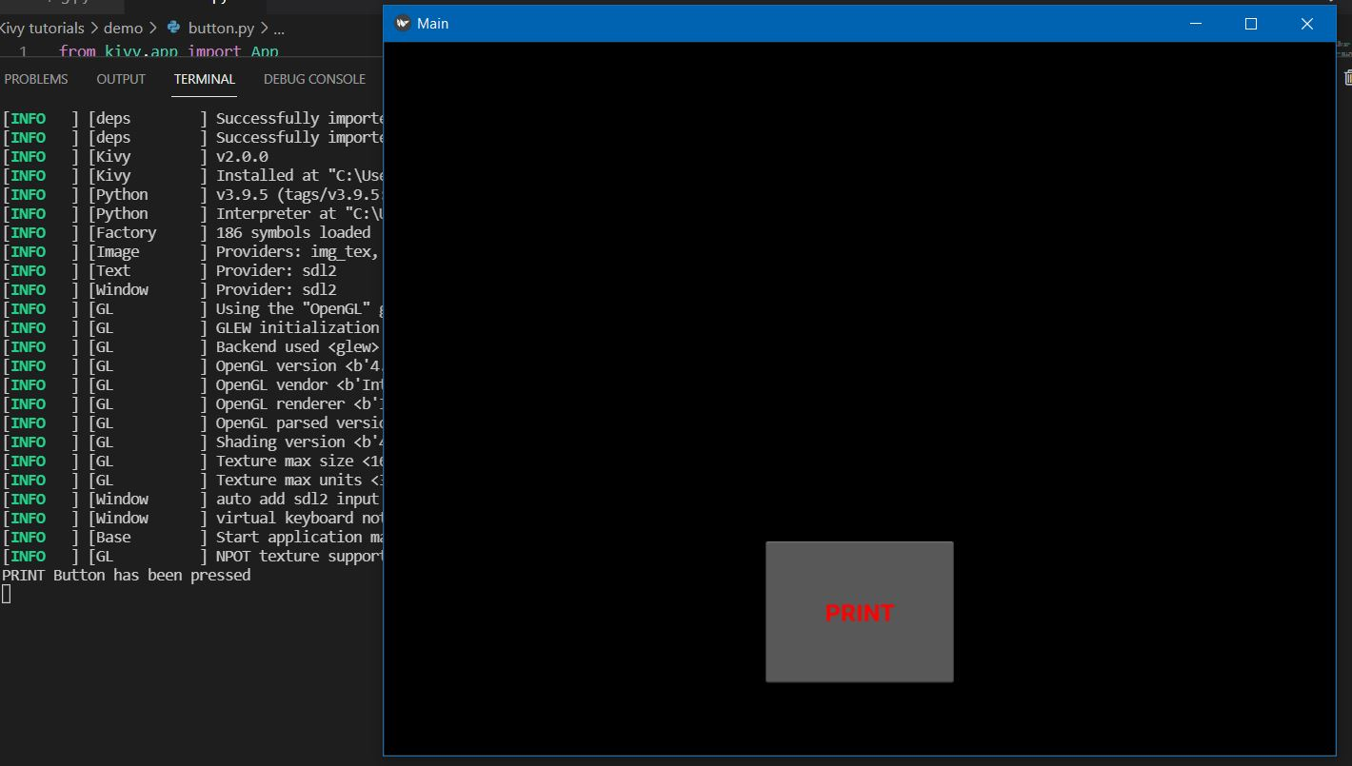
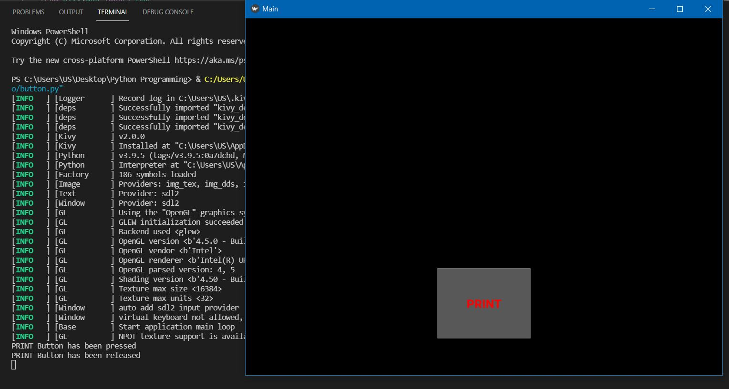
Output
on_press
on_release

Slide 5
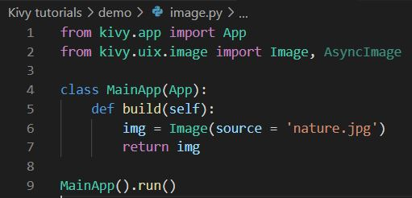
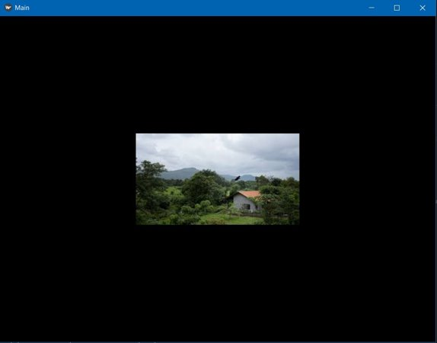
Image
Import kivy app --> from kivy.app import App
Import Image --> from kivy.uix.image import Image, AsyncImage
Import Image --> For accessing local image (filename, path)

Slide 6
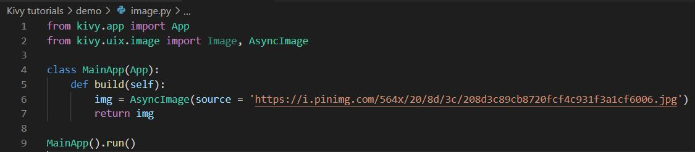
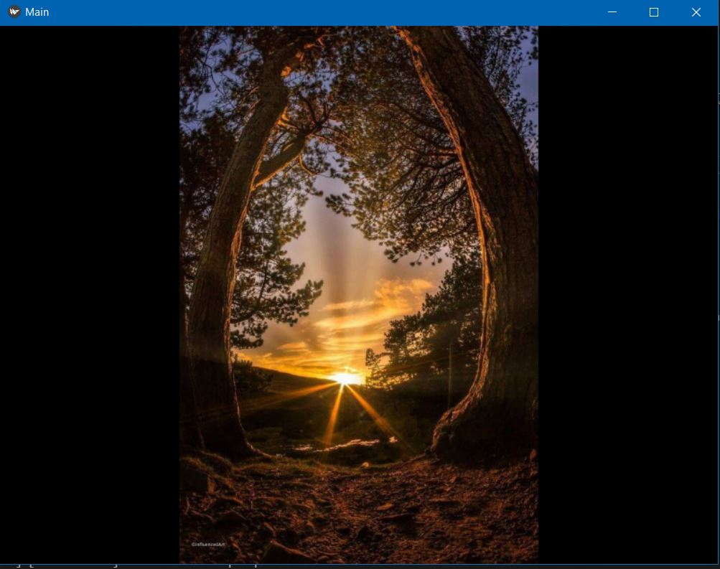
Import AsynImage
For accessing image via Network (URL)
URL must be end with .jpg

Slide 7
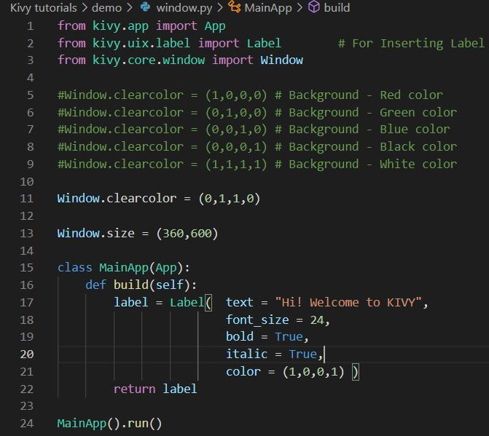
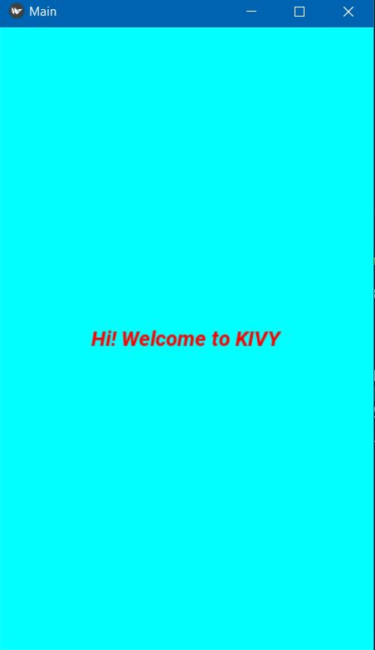
Window
Import kivy app --> from kivy.app import App
Import Label --> from kivy.uix.label import Label
Import Window --> from kivy.core.window import Window
Window.clearcolor
For changing app window's background color
Must be in a tuble or list
Ex: (1,1,1,1)
Window.size
For changing app window's size
Ex: (360, 600) --> Size for mobile based app

